Slide 1
Overview: Relational Abstractions
Bill Howe, PhD
Director of Research, Scalable Data Analytics
University of Washington eScience Institute

Slide 2
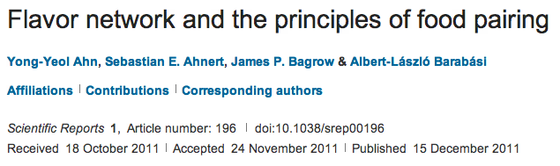

Slide 3
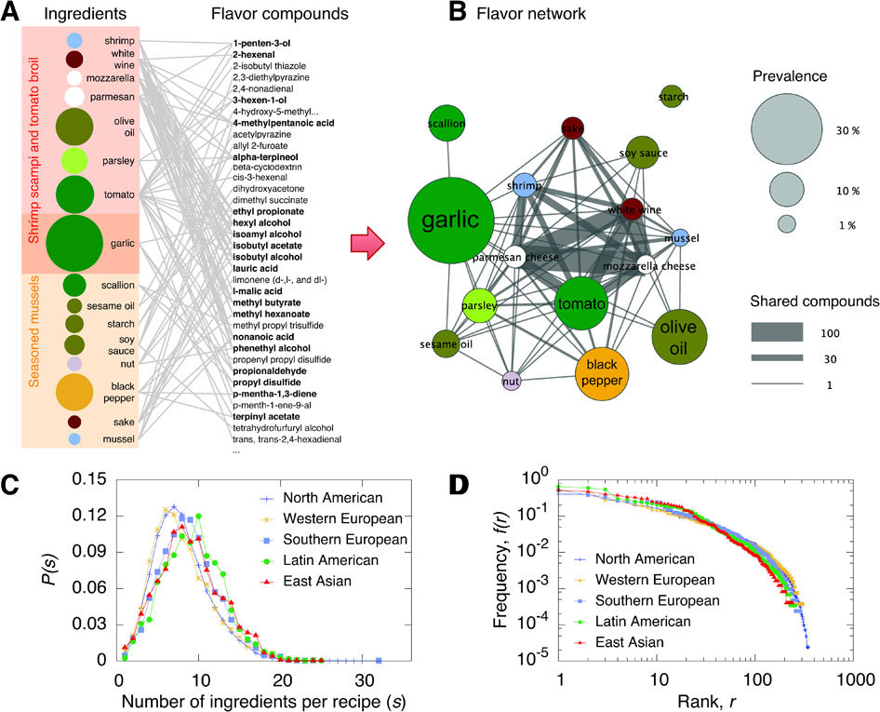

Slide 4
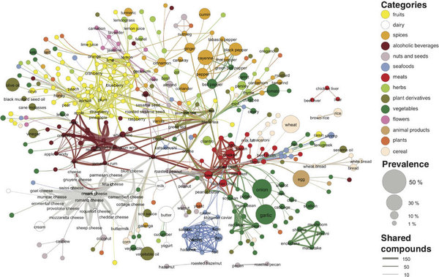

Slide 5
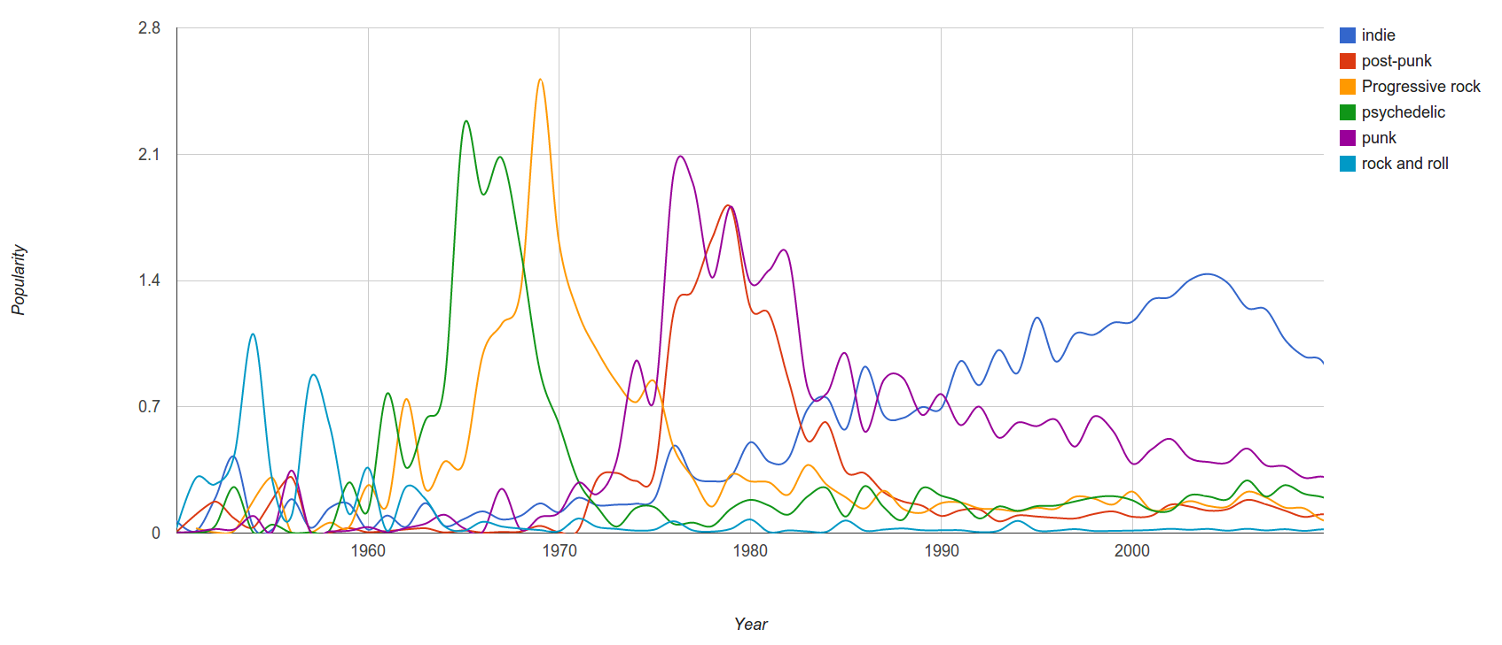
Last.FM
Since we have a massive amount of user tag data available we can easily correlate tags and years and measure “popularity” of a genre by counting the number of artists formed in a specific year.

Slide 6
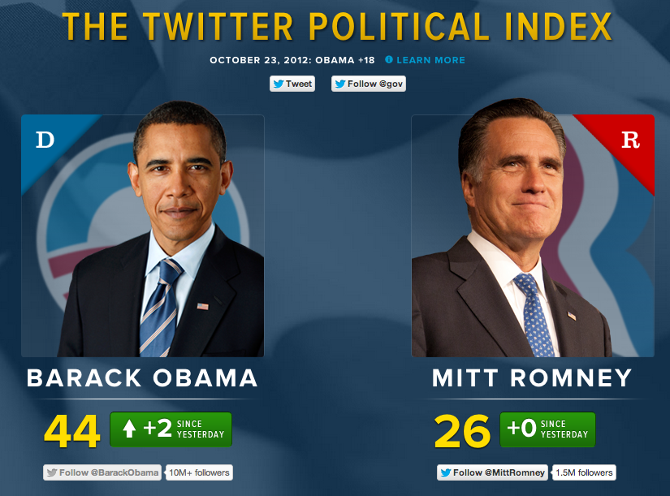

Slide 7

"people who listened to X also listened to Y"

Slide 8


Slide 9


Slide 10
Roadmap
Bonus slides from last lecture
Relational Algebra and query evaluation
In-Database Analytics
Demo

Slide 11
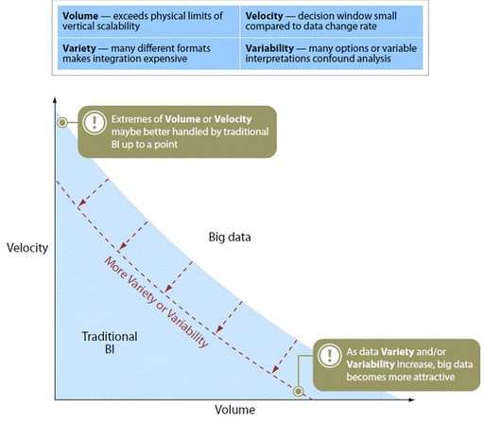

Slide 12
Relational Database History
Pre-Relational: if your data changed, your application broke.
Early RDBMS were buggy and slow (and often reviled), but required only 5% of the application code.
“Activities of users at terminals and most application programs should remain unaffected when the internal representation of data is changed and even when some aspects of the external representation are changed.”
-- Codd 1979
Key Ideas: Programs that manipulate tabular data exhibit an algebraic structure allowing reasoning and manipulation independently of physical data representation
Notes:
It provides a means of describing data with its natural structure only--that is, without superimposing any additional structure for machine representation purposes. Accordingly, it provides a basis for a high level data language which will yield maximal independence between programs on the one hand and machine representation on the other.

Slide 13
Key Idea: Data Independence
SELECT *
FROM my_sequences
views
logical data independence
SELECT seq
FROM ncbi_sequences
WHERE seq = ‘GATTACGATATTA’;
relations
physical data independence
f = fopen(‘table_file’);
fseek(10030440);
while (True) {
fread(&buf, 1, 8192, f);
if (buf == GATTACGATATTA) {
. . .
files and pointers

Slide 14
Key Idea: Indexes
Databases are especially, but not exclusively, effective at “Needle in Haystack” problems:
Extracting small results from big datasets
Transparently provide “old style” scalability
Your query will always* finish, regardless of dataset size.
Indexes are easily built and automatically used when appropriate
CREATE INDEX seq_idx ON sequence(seq);
SELECT seq
FROM sequence
WHERE seq = ‘GATTACGATATTA’;
*almost

Slide 15
Key Idea: An Algebra of Tables
select
project
join
join
Other operators: aggregate, union, difference, cross product
Notes:
It turns out that you can express a wide variety of computations using only a handful of operators.

Slide 16
Key Idea: Algebraic Optimization
N = ((z*2)+((z*3)+0))/1
Algebraic Laws:
1. (+) identity: x+0 = x
2. (/) identity: x/1 = x
3. (*) distributes: (n*x+n*y) = n*(x+y)
4. (*) commutes: x*y = y*x
Apply rules 1, 3, 4, 2:
N = (2+3)*z
two operations instead of five, no division operator
Same idea works with the Relational Algebra!

Slide 17
Key Idea: Declarative Languages
Find all orders from today, along with the items ordered
SELECT *
FROM Order o, Item i
WHERE o.item = i.item
AND o.date = today()
join
o.item = i.item
select
date = today()
scan
scan
Item i
Order o

Slide 18
Example Query in Relational Algebra
R(subject, predicate, object)
SELECT r1.subject
FROM R r1, R r2, R r3
WHERE r1.predicate = ‘knows’
AND r2.predicate = ‘holdsAccount’
AND r3.predicate = ‘accountHomepage’
AND r1.object = r2.subject
AND r2.object = r3.subject
π
_{r1.subject}
_{left.object = right.subject}
_{left.object = right.subject}
σ
_{predicate=accountHomepage}
σ
σ
_{predicate=knows}
_{predicate=holdsAccount}

Slide 19
Equivalent logical expressions; different costs
σ_{p=knows}(R) _{o=s} (σ_{p=holdsAccount}(R) _{o=s} σ_{p=accountHomepage}(R))
right associative
(σ_{p=knows}(R) _{o=s} σ_{p=holdsAccount}(R)) _{o=s} σ_{p=accountHomepage}(R)
left associative
σ_{p1=knows} & p2=holdsAccount & p3=accountHomepage & r1.o=r2.s & r2.o=r3.s (R x R x R)
cross product

Slide 20
Same logical expression, different physical algorithms
A = select(p=knows)
B = select(p=holdsAccount)
C = select(p=accountWebpage)
hA = hash(A)
AB = probe hA with B
hC = hash(C)
ABC = probe hC with AB
A = select(p=knows)
B = select(p=holdsAccount)
C = select(p=accountWebpage)
hB = hash(B)
AB = probe hB with A
hC = hash(C)
ABC = probe hC with AB
Which is faster?

Slide 21
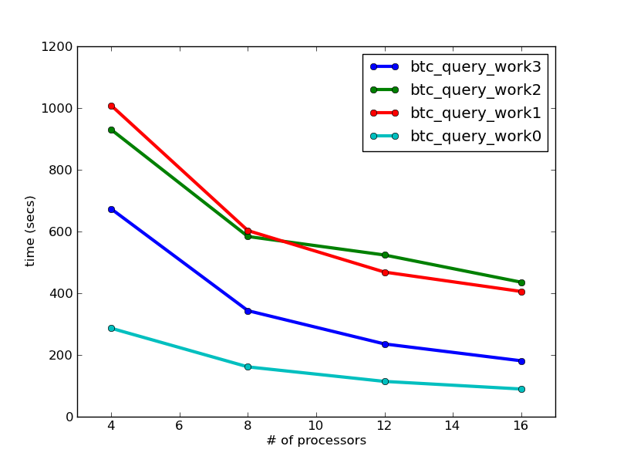
Algebraic Optimization Matters
BTC 2010 Dataset
3B quads
623 GB processed

Slide 22
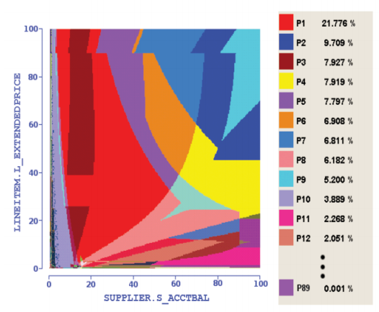
Haritsa, VLDB 2010
Picasso Query Plan Diagrams
Notes:
Each color is a different plan for the same basic query, varying only in the selectivity of the predicates

Slide 23
In-Database Analytics

Slide 24
“There is no point in bringing data ... into the data warehouse environment without integrating it. If the data arrives at the data warehouse in an unintegrated state, it cannot be used to support a corporate view of data. And a corporate view of data is one of the essences of the architected environment.”
Inmon, 2005, “Building the Data Warehouse”
Not a good fit for analytics!

Slide 25
Matrix Addition, vector representation
A(row_number, row float[])
B(row_number, row float[])
SELECT A.row_number, A.vector + B.vector
FROM A, B
WHERE A.row_number = B.row_number;

Slide 26
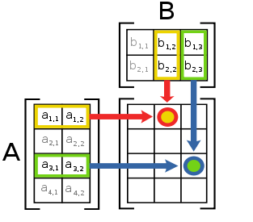
Matrix Multiplication

Slide 27
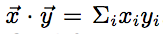
Matrix multiplication, vector representation
A(row_number, row float[])
SELECT 1, array_accum(row_number, vector*v) FROM A;

Slide 28
Matrix Transpose, vector representation
A(row_number, row float[])
SELECT S.col_number, array_accum(A.row_number, A.vector[S.col_number])
FROM A, generate_series(1,3) AS S(col_number)
GROUP BY S.col_number;
generate_series is a table function

Slide 29
Matrix Multiplication, sparse representation
A(row_number, column_number, value)
B(row_number, column_number, value)
SELECT A.row_number, B.column_number, SUM(A.value * B.value)
FROM A, B
WHERE A.column_number = B.row_number
GROUP BY A.row_number, B.column_number

Slide 30
Aside: User-defined functions and types
Scalar functions
SELECT myfunc(r.a, r.b)…
Aggregate functions
SELECT concat(r.s) …
Table functions
SELECT … FROM tablefunc(a,b)

Slide 31
Experiment design
CREATE VIEW design AS
SELECT a.trial_id,
floor (100 * random()) AS row_id
FROM generate_series(1,10000) AS a (trial_id),
generate_series(1,3) AS b (subsample_id)
CREATE VIEW trials AS
SELECT d.trial_id, AVG(a.values) AS avg_value
FROM design d, T
WHERE d.row_id = T.row_id
GROUP BY d.trial_id
src: Cohen et al., VLDB 2009

Slide 32
Prior to the implementation of this functionality within the DBMS, one Greenplum customer was accustomed to calculating the OLS by exporting data and importing the data into R for calculation, a process that took several hours to complete. They reported signicant performance improvement when they moved to running the regression within the DBMS. Most of the benet derived from running the analysis in parallel close to the data with minimal data movement.
src: Cohen et al., VLDB 2009

Slide 33
Assignment
Matrix Addition for Sparse Representation in SQL
Assume the following schema:
A(row_number, column_number, value)
B(row_number, column_number, value)
Bonus: tf-idf in a series of SQL statements
Assume the following schema:
frequency(term, docid, count)

Slide 34
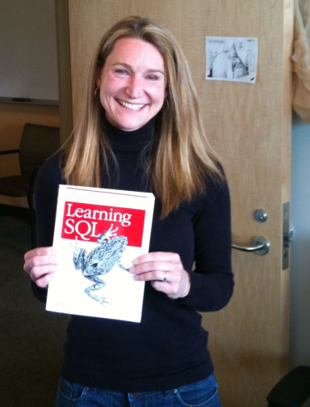
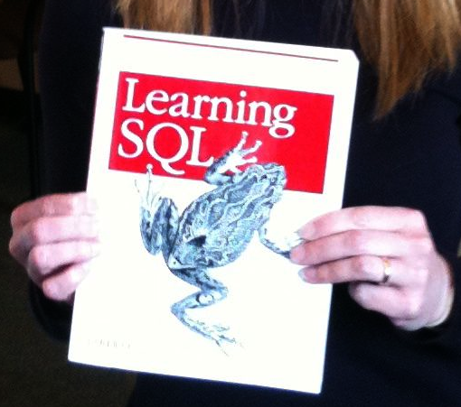
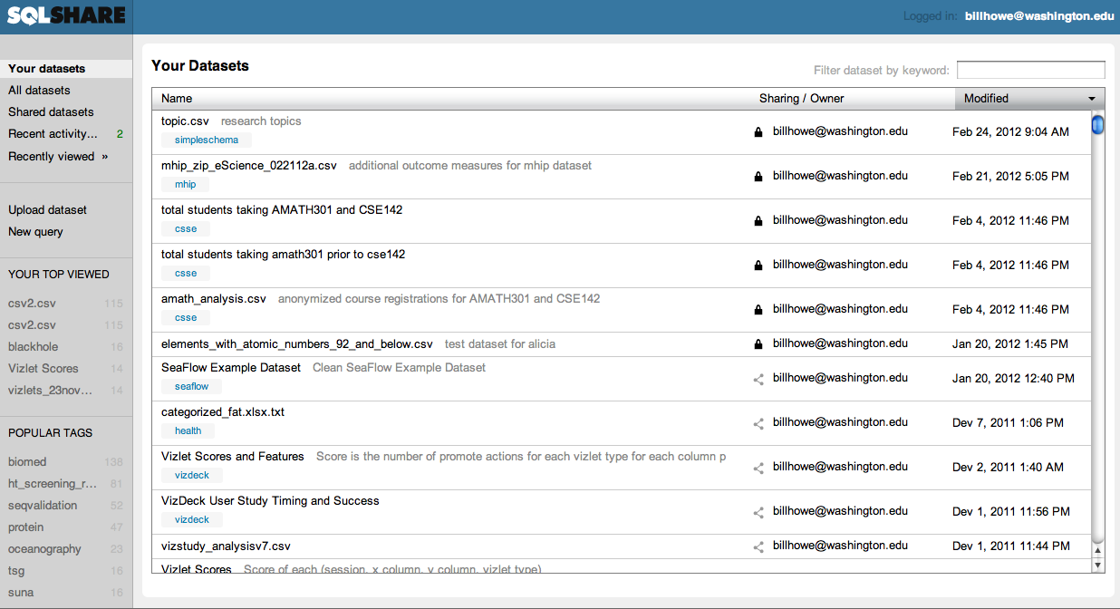
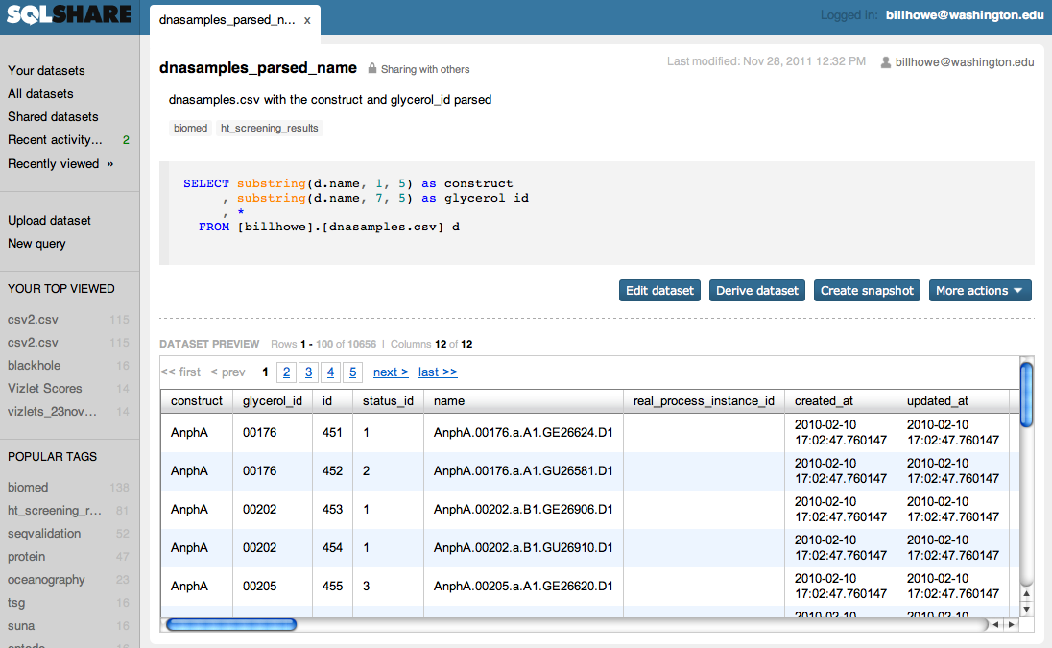
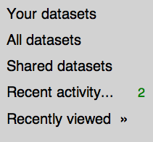
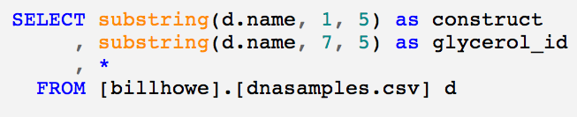
Database-as-a-Service for the 99%
Query
Approach: Strip down databases to bare essentials
Upload -> Query -> Share
Try to eliminate installation, configuration, schema design, data loading, tuning, app-building
easy, thanks to the cloud
harder

Slide 35




Getting Data In
Upload data through a browser to a cloud database (so no need to manage a local system)
No need to “design a database” before you use your data – just upload and get to work
Write SQL queries, with some automated help and some guided help from experts
Build on your own results
Output of one query can be the input to another
Encourages sharing and reuse
Avoids everyone on the team running the same data processing steps over and over
Provides provenance – “how did you get this result?”

Slide 36
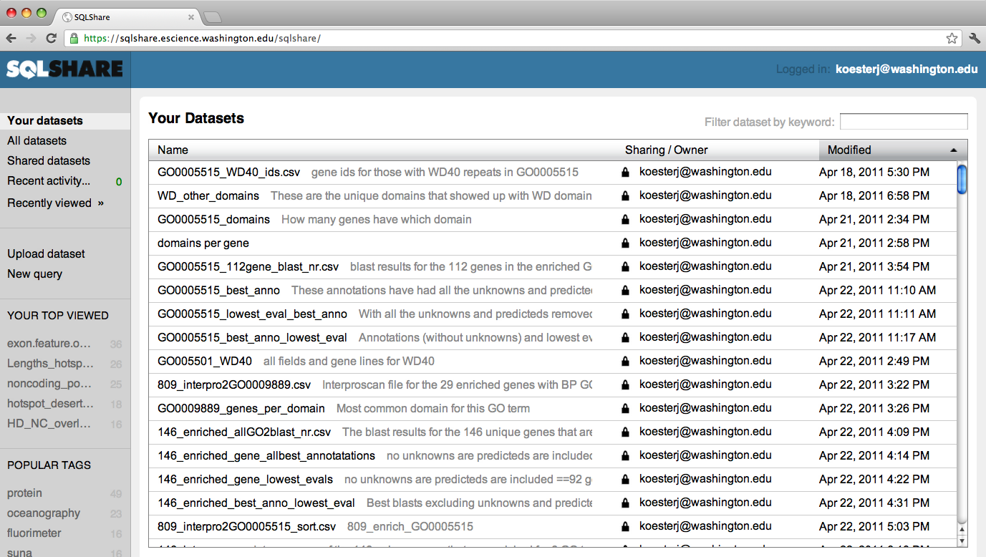
Select from a list of English descriptions
Notes:
List of English descriptions

Slide 37
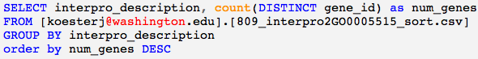
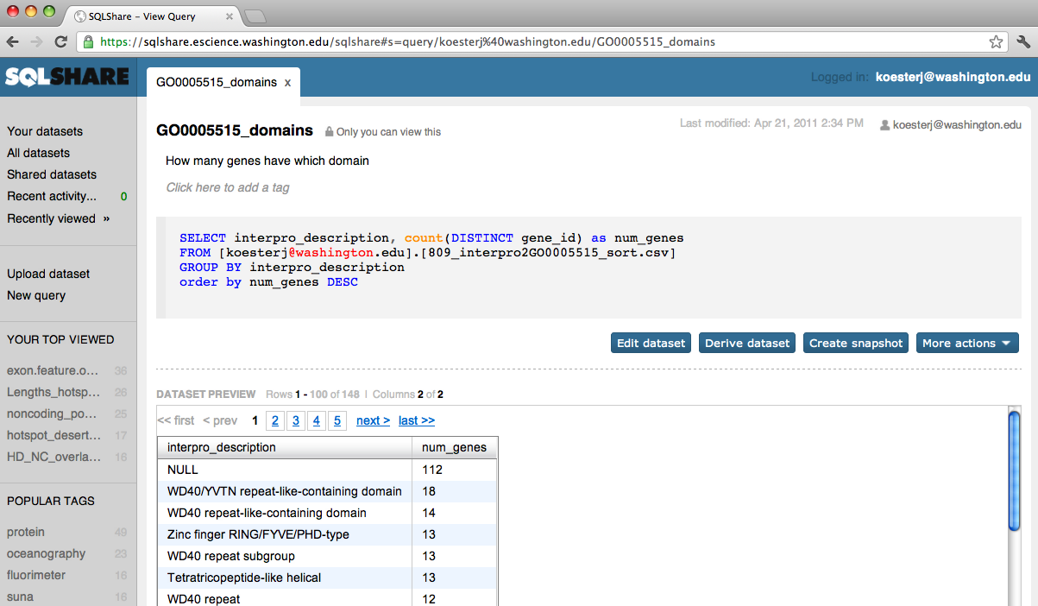
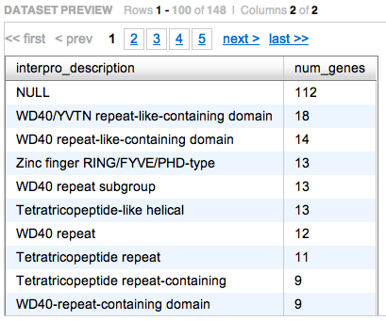
Edit a Query
Save the results, share them with others

Slide 38
http://sqlshare.escience.washington.edu

Slide 39
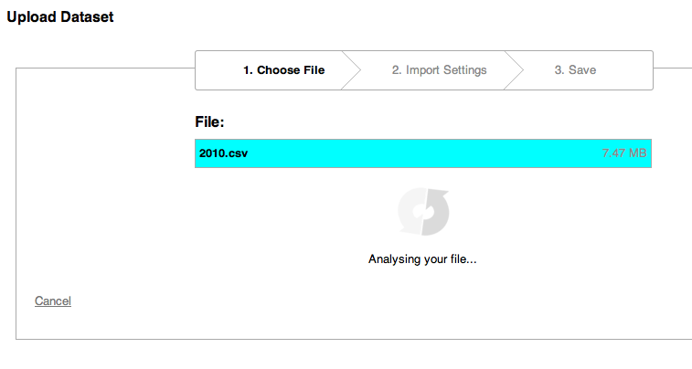
http://sqlshare.escience.washington.edu
Notes:
Data files can be uploaded as is, and we make an attempt to automatically infer the appropriate schema based on a type analysis of the values and a variety of heuristics.

Slide 40
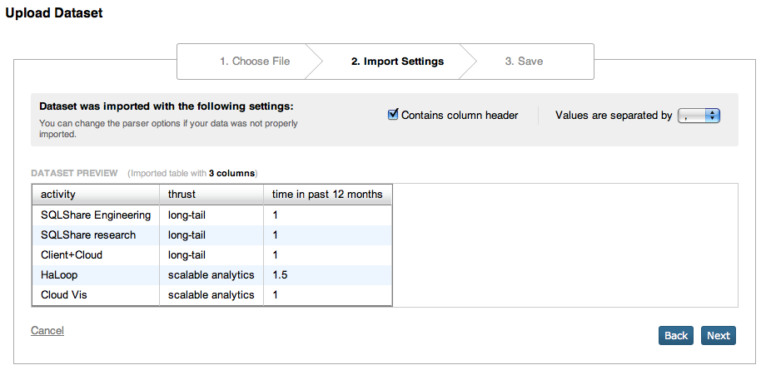
http://sqlshare.escience.washington.edu
Notes:
goal is to be inclusive rather than exclusive: accept everything, then clean it up with queries and views.
so we can tolerate irregular number of columns, mixed-type columns, missing column names.
There is a lot more to do here. Kathleen Fisher’s work on LearnPADS provides a great mechanism for automatically inferring the structure of ad hoc data formats – Very promising for us.
Jeff Heer’s and Joe Hellerstein’s work on Data Wrangler is relevant, as is Google Refine.

Slide 41
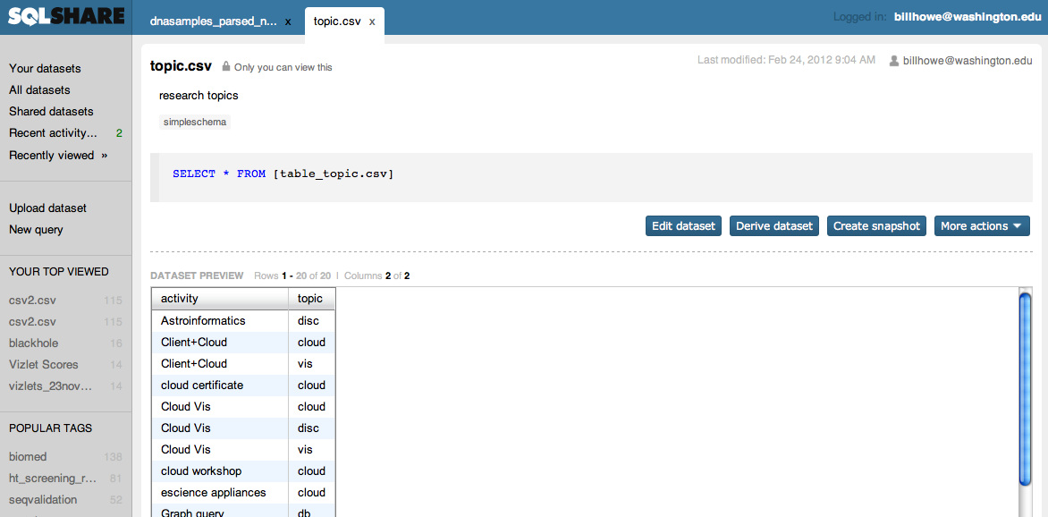
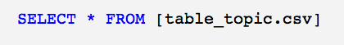
http://sqlshare.escience.washington.edu
Notes:
Every uploaded table is associated with a trivial view. You can modify this view to do some basic cleanup, and in fact that is typically the first step we are seeing people perform.

Slide 42
http://sqlshare.escience.washington.edu
Notes:
Lots of features you can imagine here – anything you can do with a youtube video, you should be able to do with a query: share it, rate it, “more like this”, recommendations,
We are exploring some of these.

Slide 43

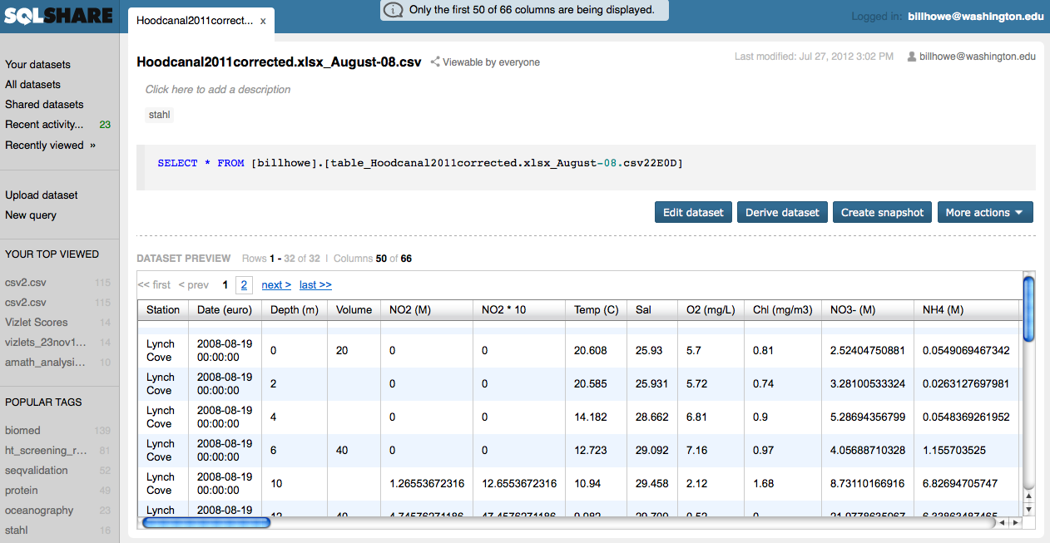
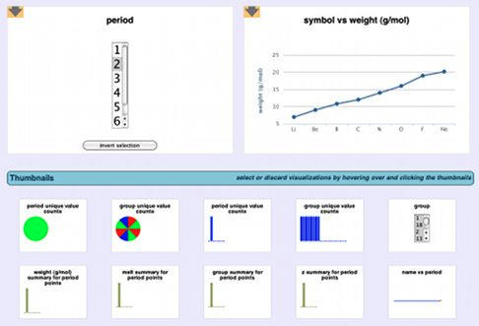


Spreadsheet Crawler
Excel Addin
Python Client
R Client
“Flagship” SQLShare App
(Python) on EC2
VizDeck
ASP.NET
OAuth2
SQLShare REST API
WCF

Slide 44
Backup Slides

Slide 45
Term frequency, inverse document frequency (tf-idf)
a(row_id, row_v)
row_v is a document vector
SELECT a1.row_id AS document_i
, a2.row_id AS document_j,
(a1.row_v * a2.row_v) /
((a1.row_v * a1.row_v) * (a2.row_v * a2.row_v)) AS theta
FROM a AS a1, a AS a2
WHERE a1.row_id > a2.row_id

